Slide 1
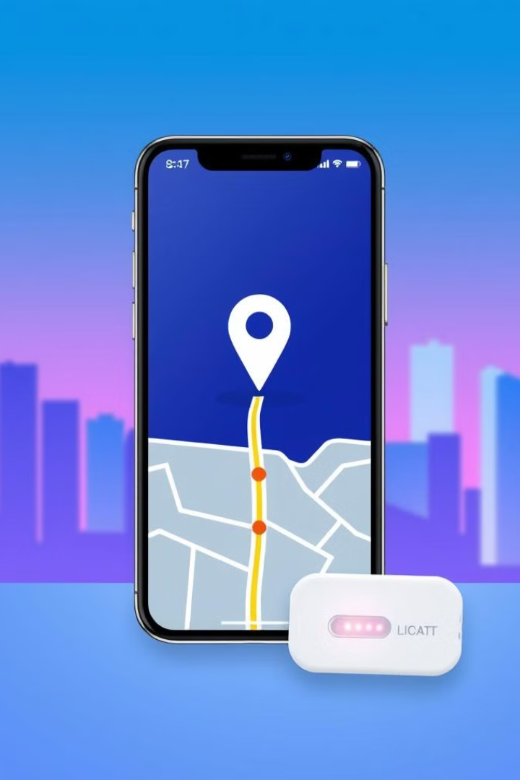
Smart Proximity Alert System for Personal Belongings
PROXY-SMART
In today’s fast-paced world, protecting personal belongings is a critical concern for individuals, especially in crowded and unfamiliar environments. Traditional security methods often fall short in preventing theft or accidental loss.
To address this challenge, we propose an innovative solution that combines an electronic device with a mobile app to create a Proximity-Based Security System. This system enables users to set a distance threshold via the app, triggering an alarm on both the device and the smartphone if the set distance is breached.

Slide 2
Problem Statement
Rising Theft
Ineffective Security
Need for Proactive Prevention
Thefts of personal belongings are rising in crowded public areas due to increased density and sophisticated techniques.
CCTV and security guards are reactive, not proactive, with slow response times and reliance on post-incident investigation.
Current solutions are costly and inconvenient. A user-friendly, affordable system with real-time alerts is needed.

Slide 3
Context and Opportunity
1
Rising Theft and Loss
Theft and misplaced belongings are increasingly common, especially in crowded public areas . This impacts many people, causing significant financial and emotional distress .
2
Limitations of Current Solutions
Existing solutions, such as GPS trackers and alarm systems, often fall short. They can be complex, expensive, and lack immediate alerts – crucial for theft prevention.
3
Potential of New Technologies
New technologies offer affordable, real-time monitoring. Device can trigger immediate alerts when items are moved, while Bluetooth enables easy tracking.

Slide 4
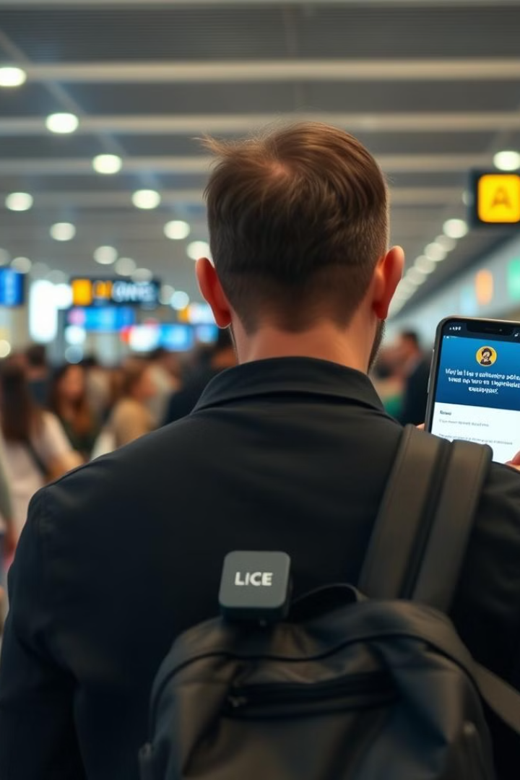
Importance of the Solution
Theft Prevention
Practical Engineering
Immediate alerts when belongings are moved beyond a set proximity deter theft and aid in recovery.
Combines hardware design (Bluetooth modules, microcontrollers) and software development (app creation).
User-Centric Design
Smart Security
Intuitive and accessible solutions enhance user safety and convenience.
Showcases how electronics and software engineering can address everyday challenges effectively.

Slide 5
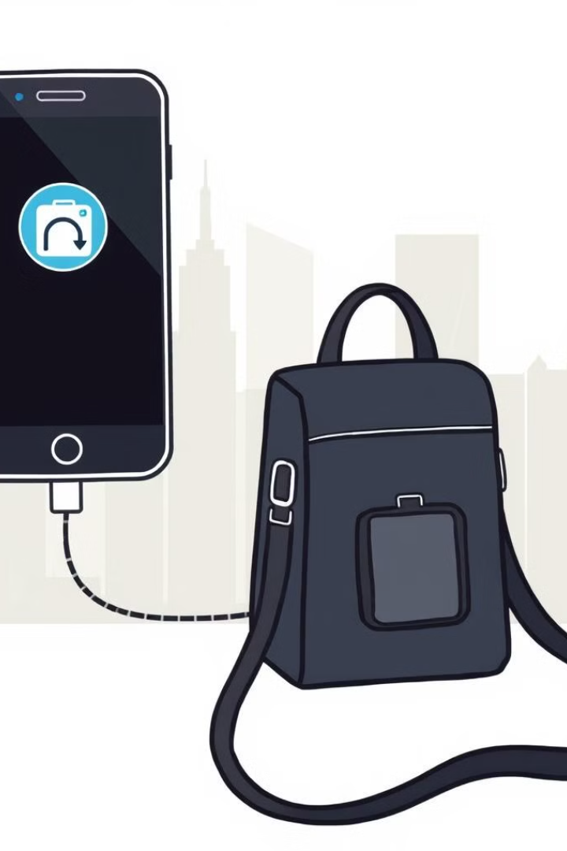
Design Objectives
Proactive Alerts
Customizable Settings
The system instantly alerts users when belongings leave the set proximity.
Users personalize security settings (proximity, alerts, etc.) via a user-friendly app.
Ease of Use
Lost-Device Recovery
Simple on/off via app or button; app-only alarm resets enhance security.
Unique device IDs and optional contact details aid in tracking and recovery.

Slide 6
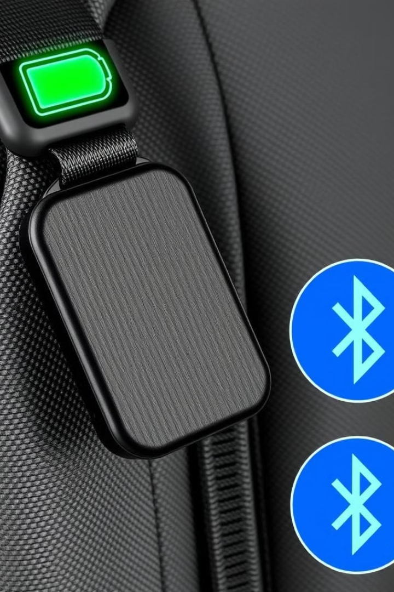
Design Constraints
Low Power Consumption
Compact Form Factor
The device needs to be small and lightweight for convenient attachment to personal items.
The device must operate efficiently to maximize battery life.
Limited Connectivity Range
Affordability
Low manufacturing costs are crucial for broad market accessibility.
Short-range Bluetooth communication ensures precise proximity detection.

Slide 7
Project Relevance:
Universal Problem
Increased Efficiency
Broad Accessibility
Misplacing or losing personal belongings is a common frustration, causing wasted time, potential financial losses, and emotional distress. Our project tackles this widespread problem with a simple, affordable, and reliable solution.
By reducing lost items, we improve efficiency and reduce costs, providing users with greater peace of mind. This isn't just a technological improvement; it's a practical solution to a daily inconvenience affecting many.
Our solution's simplicity and affordability make it accessible to a wide range of users, unlike more complex tracking systems.

Slide 8
Challenges and Solutions:
Challenge 1
Solution 1
Ensuring stable Bluetooth connectivity within varying distances.
Used Bluetooth Low Energy (BLE) protocols for stable and energy-efficient communication and tested extensively across different environments.
Challenge 2
Solution 2
Accurately detecting proximity breaches without false positives.
Implemented a signal strength filtering algorithm to reduce noise and ensure accurate threshold detection.
Challenge 3
Solution 3
Minimizing battery consumption of the device while maintaining functionality.
Optimized power management settings and employed low-power components to maximize battery life.
Challenge 4
Solution 4
Designing a user-friendly interface that is intuitive and easy to navigate.
Developed a simple and clear interface with minimal steps required for operation, providing users with an intuitive experience.

Slide 9
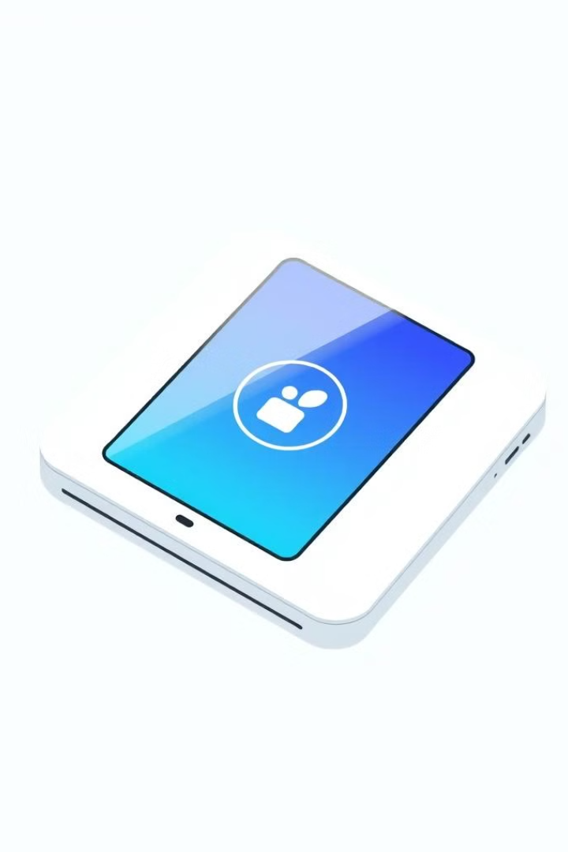
Prototype Development: Aesthetics and Ergonomics
Aesthetics & UI
Ergonomics & UX
The app boasts intuitive navigation, a clean design, and customizable alerts. A calming color palette and clear icons enhance usability, further improved by haptic feedback.
Setup is simple and quick. The efficient workflow minimizes steps, while regular feedback ensures ease of use. Usability testing confirmed accessibility and minimized errors.

Slide 10
Prototype Development: Functional Prototype
Bluetooth Connectivity
1
Uses Bluetooth Low Energy (BLE) for low-power communication between the tag and app, ensuring efficient battery life and robust connection.
2
User Authentication
Secure user access via unique device ID and password; includes password recovery.
Proximity Ranges
3
Customizable proximity thresholds via the app; provides visual feedback on range and alerts.
4
Dual-Device Alerting
Simultaneous alerts to the app and tag's LED; ensures notification even with app issues.
Alert System Logic
5
Sophisticated algorithm filters false positives; handles connectivity issues and interference.
6
Data Storage and Management
Secure data storage with encryption; optional cloud backup with HTTPS secured communication.

Slide 11
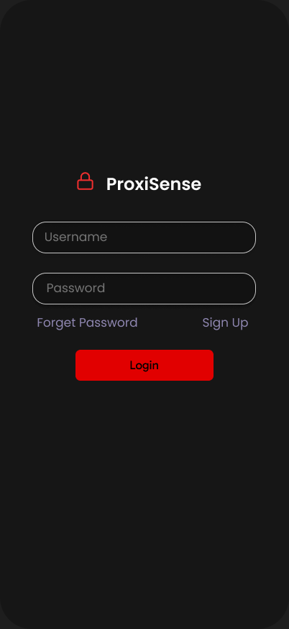
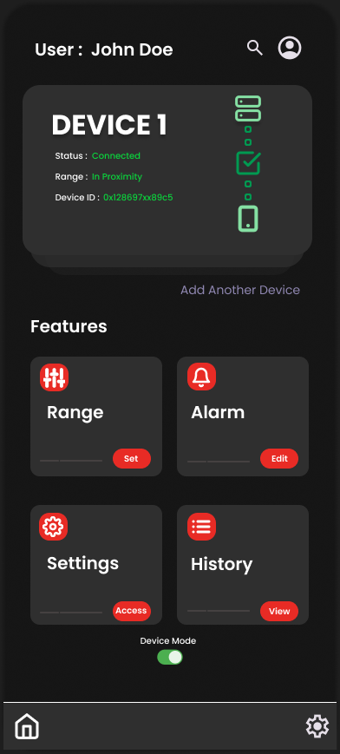
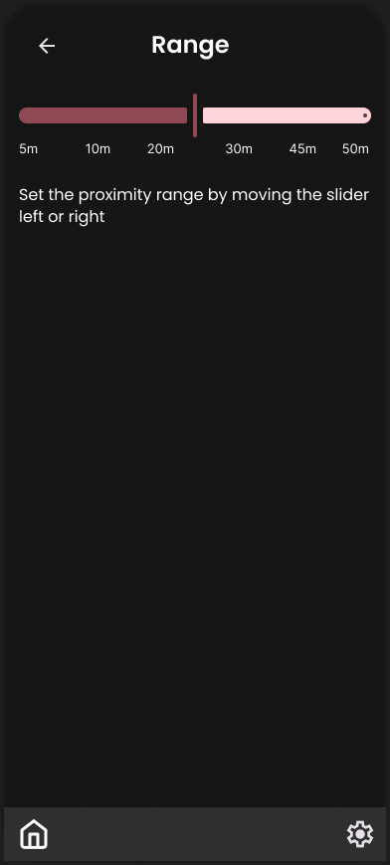
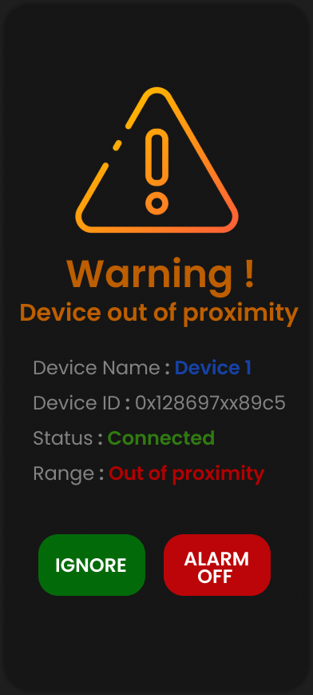
App Screenshots

Slide 12
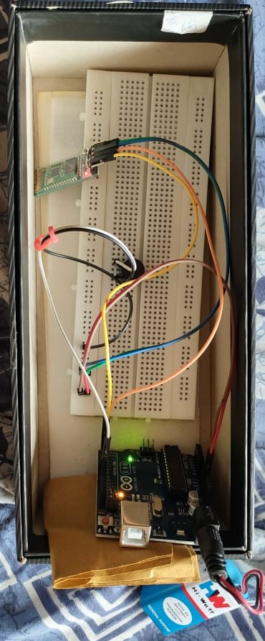
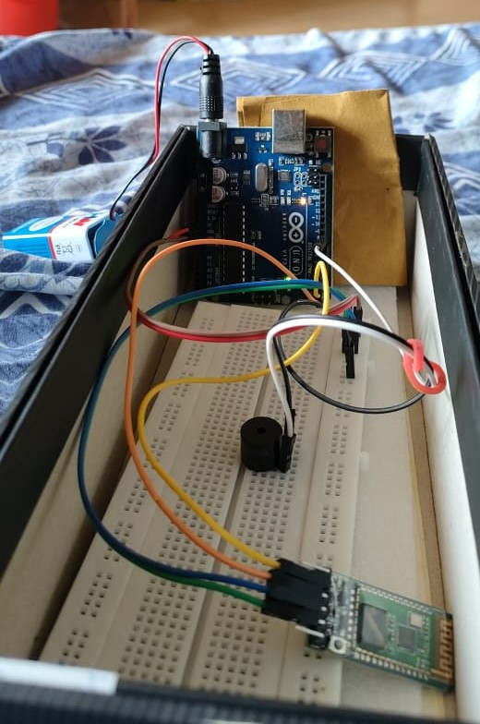
Working Prototype :

Slide 13
Conclusion and Future Work
Functional Prototype
1
A functional prototype was successfully developed, demonstrating effective prevention of theft and loss of personal items.
2
User Testing Insights
Key design improvements resulted from user testing.
Iterative Design Success
3
Iterative feedback loops significantly improved the product, ensuring it effectively met user needs.
4
Future Improvements: Bluetooth Optimization
Initial Bluetooth connectivity challenges were addressed through rigorous testing and protocol optimization.
Future Improvements: User Feedback Integration
5
User feedback significantly enhanced user experience and usability.

Slide 14
REFERENCES:
Arduino (2025). Arduino Uno technical documentation. Available at: https://www.arduino.cc .
Bluetooth SIG (2025). Bluetooth Low Energy: Technology Overview. Available at: https://www.bluetooth.com/what-is-bluetooth-technology/bluetooth-low-energy .
Piezo Electric Technology (2025). Applications of Piezoelectric buzzers. Available at: https://www.piezotechnologies.com.
OpenAI (2025). ChatGPT: An AI-powered conversational model for generating text. Available at: https://www.openai.com/chatgpt .
Figma (2025). Figma: Collaborative interface design tool. Available at: https://www.figma.com.
Android Developers (2025). Developing apps for Bluetooth communication. Available at: https://developer.android.com .
ISO (2010). ISO 9241-210: Ergonomics of human-system interaction. Available at: https://www.iso.org .
Mohan, R. (2021). IoT-based theft prevention systems: A comparative study. International Journal of Engineering Research, Vol. 10, No. 3, pp. 145-152.

Slide 15


